Slide 1
LIFE PROCESSES OF LIVING THINGS
By
Sushil Varma

Slide 2
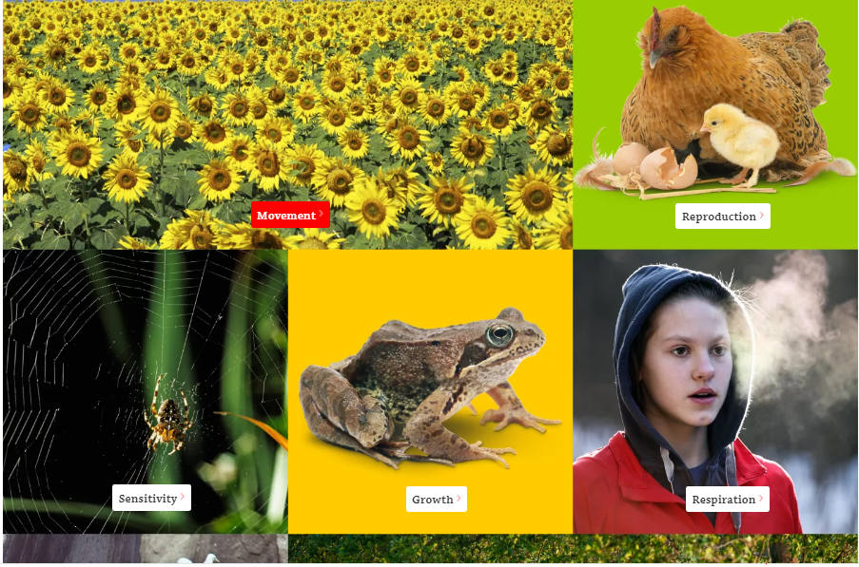
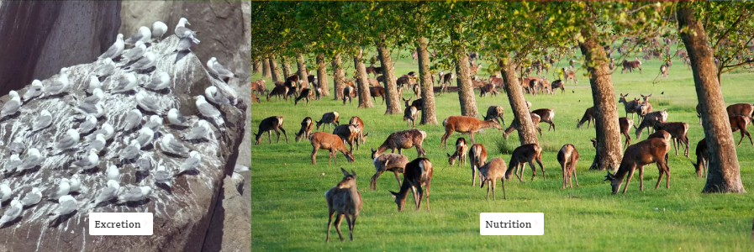
All living things have seven processes in common that
together set them apart from nonliving things. Each living things can move, Reproduce itself, and is sensitive to the world around it.
Each one can also grow, respire, excrete and make food by the process called nutrition

Slide 3
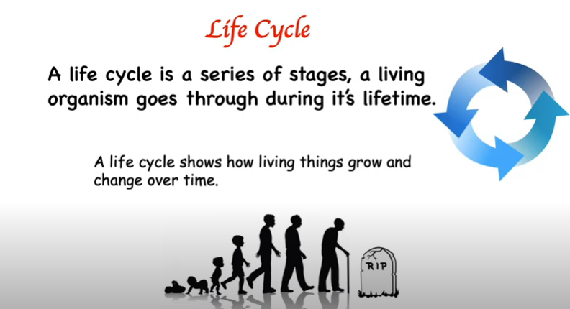
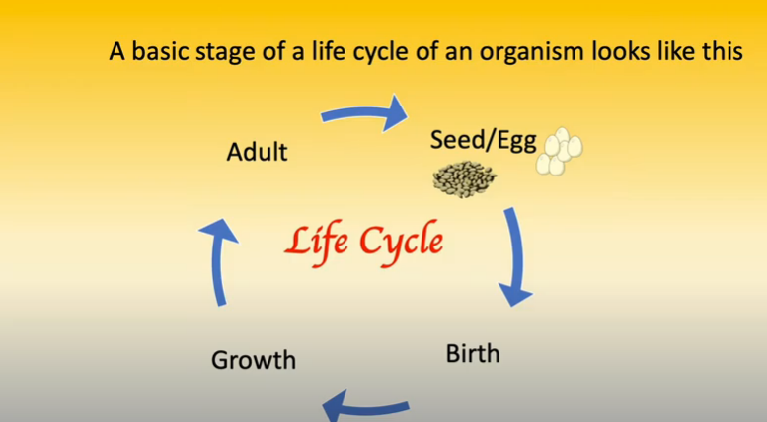

Slide 4
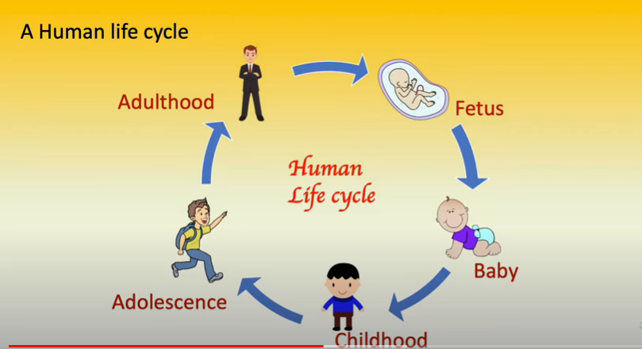

Slide 5
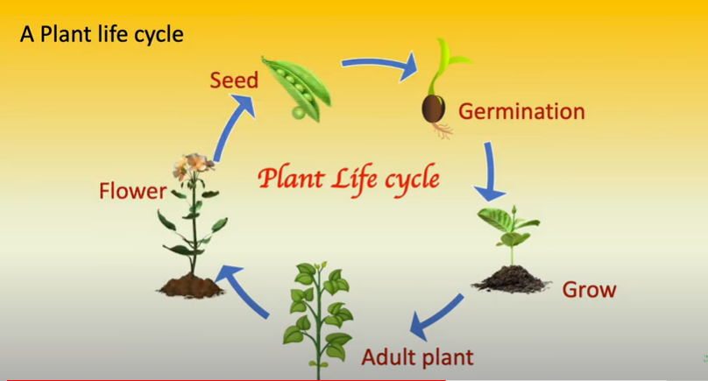

Slide 6
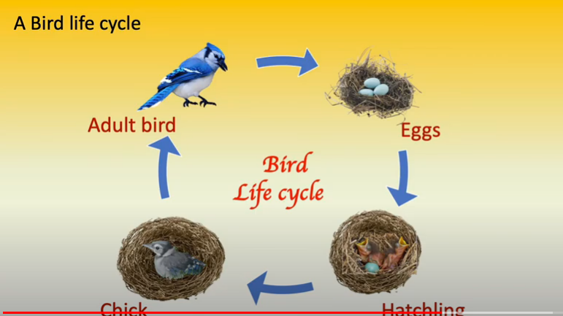

Slide 7
Thank You

